Slide 1

DB
REVIEW ON SELECT
10 min

Slide 2
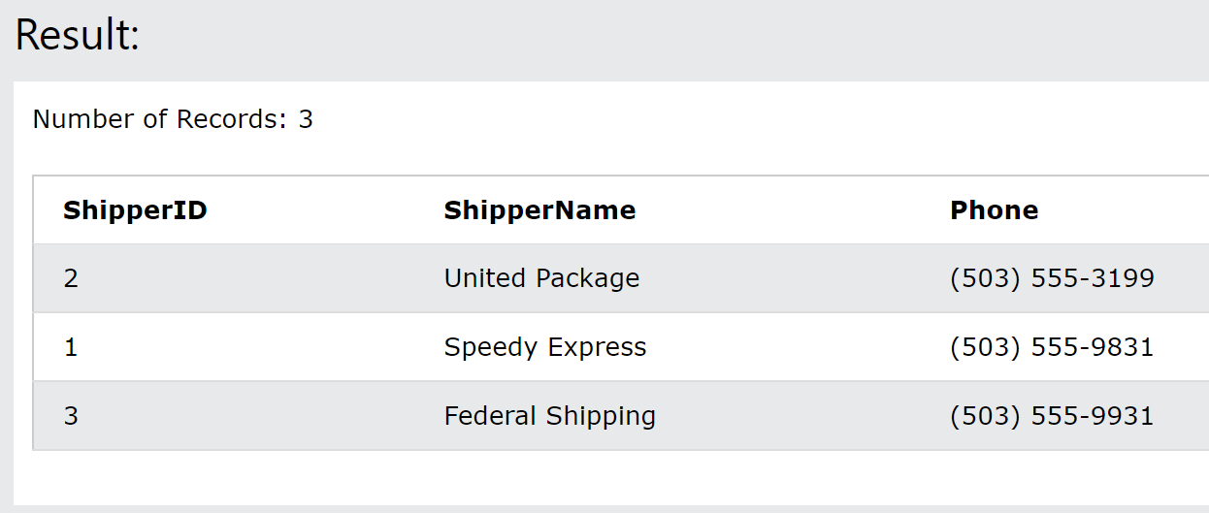
Display all information of shipper, the name must be reversing the alphabets.
SELECT * FROM Shippers order by shippername DESC;
C. SELECT * FROM Shippers order by shippername ABC;
D. SELECT * FROM Shippers order by shippername ABC;
B. SELECT * FROM Shippers order by shippername ASC;

Slide 3
Display all information of shipper, the name must be reversing the alphabets.
SELECT * FROM Shippers order by shippername DESC;
C. SELECT * FROM Shippers order by shippername ABC;
D. SELECT * FROM Shippers order by shippername ABC;
B. SELECT * FROM Shippers order by shippername ASC;

Slide 4
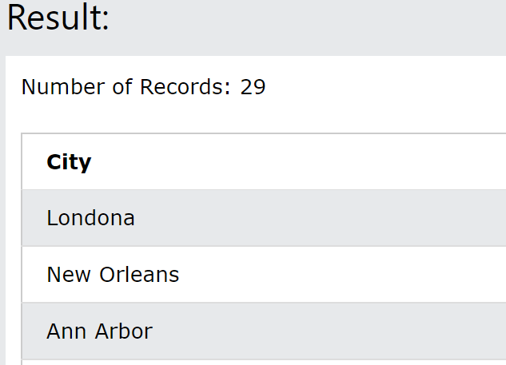
Display city without any duplicate data from suppliers.
A. SELECT distinct city from city;
C. SELECT distinct suppliername from suppliers;
D. SELECT * city from suppliers;
B. SELECT distinct city from suppliers;

Slide 5
Display city without any duplicate data from shippers.
A. SELECT distinct city from city;
C. SELECT distinct suppliername from suppliers;
D. SELECT * city from suppliers;
B. SELECT distinct city from suppliers;

Slide 6
Display city without any duplicate data from shippers.
A. SELECT distinct city from city;
C. SELECT distinct suppliername from suppliers;
D. SELECT * city from suppliers;
B. SELECT distinct city from suppliers;

Slide 7
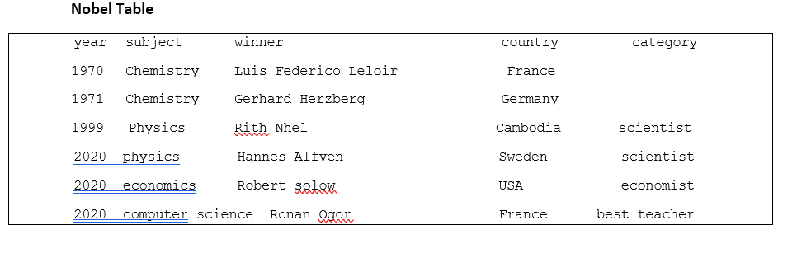
Count the numbers of winners who did not assign to any category.
A. SELECT count (winner) from category where category is null;
B. SELECT count winner from category where category is null;
C. SELECT count (winner) from novel_table where catgory is null;
D. SELECT count (winner) from novel_table where category is null;

Slide 8
Count the numbers of winners who did not assign to any category.
A. SELECT count (winner) from category where category is null;
B. SELECT count winner from category where category is null;
C. SELECT count (winner) from novel_table where catgory is null;
D. SELECT count (winner) from novel_table where category is null;

Slide 9
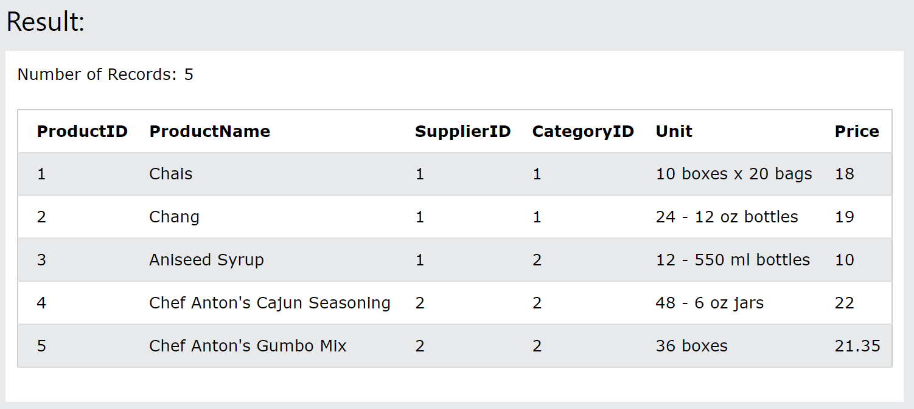
Display the first 5 products details .
A. SELECT * from products limit 5;
B. SELECT * from products limit 6;
C. SELECT * from orders limit 5;
D. SELECT * from orders limit 5;

Slide 10
Display the first 5 products details .
A. SELECT * from products limit 5;
B. SELECT * from products limit 6;
C. SELECT * from orders limit 5;
D. SELECT * from orders limit 5;

Slide 11
Display all winner who their name start with R and come from Cambodia .
D. SELECT winner, country FROM country WHERE Country= “Cambodia" AND winner LIKE “R%“;
C. SELECT winner, country FROM nobel_table WHERE Country= “Cambod" AND winner LIKE “R%“;
B. SELECT winner, country FROM nobel_table WHERE Country= “Cambodia" AND winner LIKE “R%%“;
A. SELECT winner, country FROM nobel_table WHERE Country= “Cambodia" AND winner LIKE “R%“;

Slide 12
Display all winner who their name start with R and come from Cambodia .
D. SELECT winner, country FROM country WHERE Country= “Cambodia" AND winner LIKE “R%“;
C. SELECT winner, country FROM nobel_table WHERE Country= “Cambod" AND winner LIKE “R%“;
B. SELECT winner, country FROM nobel_table WHERE Country= “Cambodia" AND winner LIKE “R%%“;
A. SELECT winner, country FROM nobel_table WHERE Country= “Cambodia" AND winner LIKE “R%“;

Slide 13


